Slide 1
494(P)-BAS-03: Basic Flight
Trainee Preparation
Ashilta
26 Sep 2020
26 Mar 2021

Slide 2
Lesson Overview
Principles of Flight
The Circuit
Taking Off
Basic Manoeuvres
Landing
Conducting a Touch and Go
494(P)-BAS-03

Slide 3
Principles of Flight
Lift and AoA
Effects of Controls
Coordinated Flight
494(P)-BAS-03

Slide 4
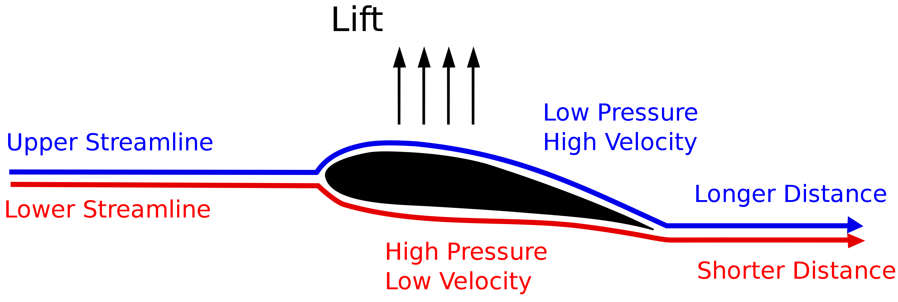
Lift and AoA
Aircraft fly by producing lift. The act of forward motion causes an imbalance in pressure across a wing and this action ‘lifts’ the wing.
The shape of the wing forces more air to collate underneath the wing, increase the pressure. The airflow over the top of the wing is of lower pressure.
494(P)-BAS-03

Slide 5
Lift and AoA
As aircraft speed increases, the pressure imbalance increases and more lift is generated, allowing an aircraft to fly.
The angle between the ‘chord line’ of a wing and the relative motion of the atmosphere is referred to as the ‘angle of attack’. A higher angle of attack (AoA) at a constant speed produces greater lift.
As the aircraft flies faster and the airflow over the wing increases, a lesser AoA is required.
494(P)-BAS-03

Slide 6
Lift and AoA
In most circumstances, a slight nose-up attitude is required to maintain level flight.
As an aircraft turns, the lift generated by one wing becomes greater than the lift generated by the other. Accordingly, it may be required for the aircraft to pitch up to maintain altitude.
494(P)-BAS-03

Slide 7
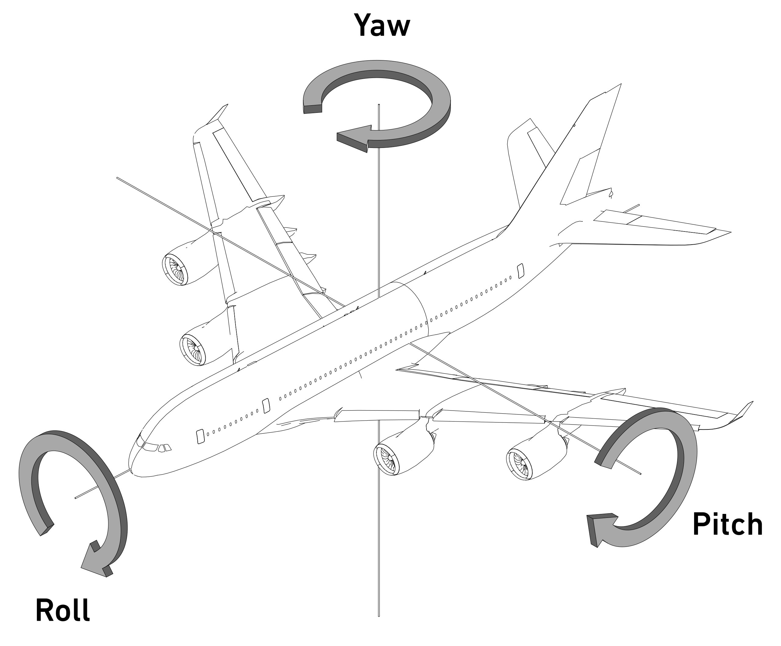
Effects of Controls
Modern aircraft have a number of control surfaces in order to manipulate airflow over the airframe. The manipulation of this airflow allows the aircraft to pitch, roll and yaw.
Combinations of these rotations around aircraft axes allow the aircraft to move in three dimensions.
494(P)-BAS-03

Slide 8
Effects of Controls
Each control has a minimum of two effects, whilst some have three:
Subsequently, many aircraft inputs require a complimentary input to keep the aircraft ‘in trim’.
Surface Name | Primary Effect | Secondary Effect | Tertiary Effect
Elevator/Horizontal Stabiliser | Aircraft Pitch | Aircraft Speed | N/A
Ailerons | Aircraft Roll | Aicraft Yaw | Asymmetric Lift
Rudder | Aircraft Yaw | Aircraft Roll | Asymmetric Lift
Speed brake | Aircraft Speed | Adverse Pitch | N/A
Flaps | Aircraft Pitch | Adverse Drag | N/A
494(P)-BAS-03

Slide 9
Coordinated Flight
In order to maintain efficient flight, aircraft require many control inputs when performing certain actions.
Coordinated flight is achieved when pilots perform the necessary control inputs to counteract the undesired secondary and tertiary effects of controls.
494(P)-BAS-03

Slide 10
The Circuit
Understanding the Airfield Circuit
Leaving and Joining the Circuit
The Run and Break
Mandatory Reporting Points
494(P)-BAS-03

Slide 11
Understanding the Airfield Circuit
The ‘structure’ of the Airfield Circuit is depicted in Appendix A of 132-TTP-5 – ATC and Airbase Operations.
Typically, two circuits operate for each runway, separated by altitude – one for fixed wing aircraft and the other for rotary wing aircraft.
Where arrival or departure procedures are not provided for an airfield, the circuit provides a consistent environment which encourages flight safety and should be used by all aircraft.
494(P)-BAS-03

Slide 12
Leaving and Joining the Circuit
To promote flight safety, there are a number of standard methods for joining a circuit:
Direct entry and exit – a 45 degree track into or out of the downwind leg away from the airfield
Non-standard Overhead entry – joining over the ‘inactive’ threshold of the active runway and turning into the down-wind leg
Standard Overhead entry – flying over the active runway threshold to the ‘dead’ side, descending to circuit height and rejoining the circuit by flying over the ‘inactive’ threshold of the active runway.
Vertical exit – climbing out of the circuit along the downwind leg.
Straight in – Joining the final approach track directly
494(P)-BAS-03

Slide 13
The Run and Break
The most expeditious method for a formation to join the circuit is using the Run and Break.
The Run and Break involves a formation of aircraft flying along the axis of the active runway at speed, before turning tightly onto the downwind leg at intervals to break up the formation and reduce speed.
In the 494th VFS, the ‘initial’ is flown at 800 feet and the break commences either at the touchdown point, or as directed by ATC.
Each aircraft in the formation breaks no earlier than 5 seconds after the preceding aircraft.
The break should be flown by pulling G at 1% of the airspeed. For example, an aircraft flying at 320 knots would pull 3.2G.
494(P)-BAS-03

Slide 14
The Run and Break
As the aircraft turns through 90 degrees in the break, the gear and flaps should be deployed and the pull should reduce to come ‘on speed’.
The Run and Break is concluded when the aircraft is rolled out onto the downwind leg, at a position referred to as ‘perch’.
494(P)-BAS-03

Slide 15
Mandatory Reporting Points
Within the vicinity of the aerodrome, a number of positions within the circuit and relative to the airfield are considered mandatory reporting points, requiring the pilot to report when they are in that position.
The two most common reports are ‘downwind’, typically reported abeam the middle of the landing surface, and ‘final’, when the aircraft is lined up with the landing surface and within 3 nautical miles.
Any final call, regardless of the type of approach to be flown, must include the term ‘three greens and locked’ to confirm that the landing gear is correctly deployed.
494(P)-BAS-03

Slide 16
Mandatory Reporting Points
Other mandatory reporting points include:
‘Overhead’ when an aircraft is performing a standard overhead join.
‘Descending dead-side’ when an aircraft is descending on the opposite side of the runway to the circuit direction.
For aircraft performing a Run and Break, the formation must report crossing ‘initial’.
494(P)-BAS-03

Slide 17
Taking Off
Lining Up
Taking Off
After Take-Off Checks
494(P)-BAS-03

Slide 18
Lining Up
Lining up on the runway is one of the last opportunities that pilots have to ensure their aircraft is ready for flight before taking off.
For single-aircraft departures, the aircraft should always line up on the centreline of the runway before bringing the aircraft to a stop.
Pre-takeoff checks must be completed in accordance with the 494th SOP and Checklist.
494(P)-BAS-03

Slide 19
Taking Off
Taking off in the F/A-18C Hornet is a fairly simple undertaking.
Hold the aircraft in position with the wheel brakes and advance the throttle so tha the RPM of both engines reads approximately 80%. This is referred to as ‘running them up’.
Monitor the engine outputs to ensure that the engines are stable and look for any warning lights.
Keeping the Nosewheel Steering engaged, release the wheel brakes and advane the throttle to full military power – do not use the Afterburner at this stage.
494(P)-BAS-03

Slide 20
Taking Off
As the aircraft accelerates, ensure that it is moving in a straight line and advance the throttle to the top of the Afterburner range.
As the airspeed increases through 50 knots, disable the Nosewheel Steering, as the airflow over the rudder will be sufficient to yaw the aircraft.
Continue to apply small rudder inputs to the aircraft to ensure that the aircraft remains on the runway centreline.
As the airspeed passes through 140 knots, slowly apply rearward pressure on the stick to lift the nosewheel off the ground. Once sufficient lift is generated, the aircraft will take off.
494(P)-BAS-03

Slide 21
Taking Off
If at any point, something goes wrong in the takeoff run, simply reduce the throttle to idle and apply the brakes as firmly as possible, bringing the aircraft to a stop on the runway.
If you are airborne with sufficient runway to land, do so and bring the aircraft to a complete stop.
Once the aircraft is safely airborne, retract the landing gear and flaps and, if necessary, trim the aircraft for flight.
494(P)-BAS-03

Slide 22
After Take-off Checks
Once the aircraft has safely taken off and the configuration ‘cleaned up’, a number of checks should be completed.
The pilot should ensure that the aircraft is flying well and that the configuration is appropriate.
The engine performance should be monitored and no alerts should be displayed.
The aircraft lights should be appropriately configured.
The pilot should ensure that they have the means to properly navigate.
494(P)-BAS-03

Slide 23
Basic Manoeuvres
Turns
Climbs
Descents
Climbing Turns & Descents
Steep Turns
494(P)-BAS-03

Slide 24
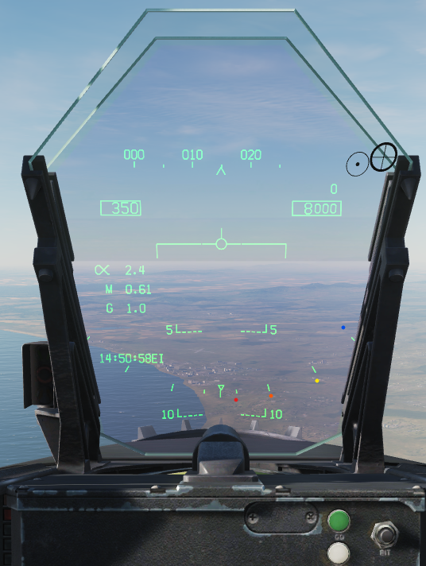
Turns
Turns are typically measured through ‘angle of bank’, with various pre-defined angles depicted on the HUD. In this image, the red dot denotes 5 degrees AoB, the orange 10 degrees, the yellow 30 degrees and the blue 45. Most turns outside of combat situations are conducted at 30 degrees angle of bank.
494(P)-BAS-03

Slide 25
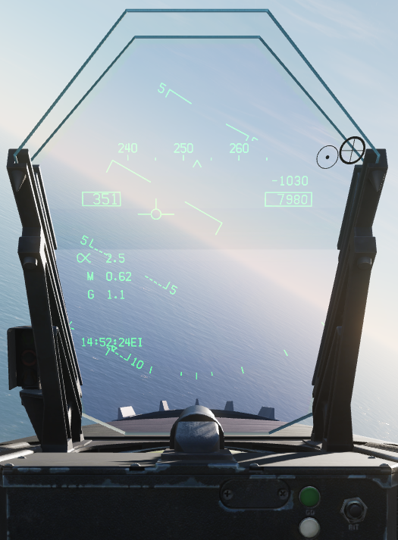
Turns
When commencing the turn, the lift generated on each wing becomes asymmetric and there is a reduction in total lift. Accordingly, the nose of the aircraft drops slightly to maintain speed.
Accordingly, slight rearward pressure is required to maintain level flight in turns. The steeper the turn, the greater the aft pressure required.
494(P)-BAS-03

Slide 26
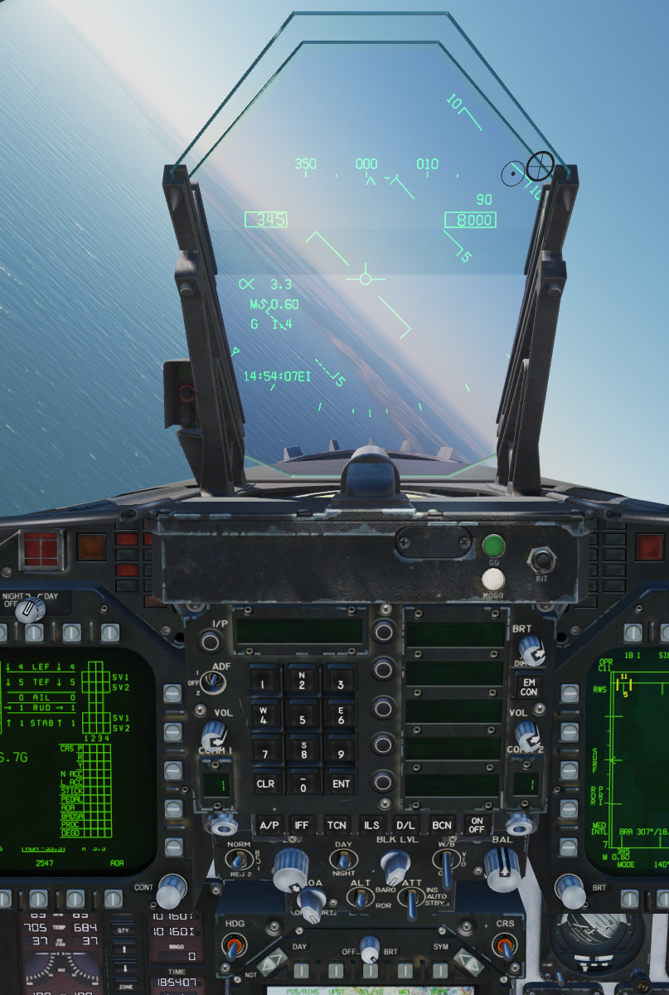
Turns
When commencing turns, the aircraft requires many control inputs to remain in coordinated flight. In this 45 degree AoB turn, the balance ball (at the bottom of the Standby Attitude Indicator under the right MFD) has drifted slightly to the left. To correct this, apply left rudder (‘step on the ball’).
494(P)-BAS-03

Slide 27
Climbs
Climbs may be performed in a number of ways. Typically, a climb is performed at whatever rate allows a speed to be maintained.
To climb, apply a slight increase in power as rearward pressure is gradually applied to the stick. If the speed begins to reduce but greater climb performance is required, apply more throttle until the speed stabilises, apply further rearward pressure and adjust.
In some occasions, a desired speed and angle of pitch will be specified. In these circumstances, advance the throttles significantly, pull back to achieve the desired pitch and adjust the throttle to maintain the required speed.
494(P)-BAS-03

Slide 28
Descents
To descend the aircraft and maintain coordinated flight, forward pressure should be applied to the stick to ‘drop’ the nose of the aircraft.
As gravity will help to accelerate the aircraft, the throttle should be reduced to control the speed of the aircraft.
The use of the speedbrake to reduce or maintain speed should be avoided wherever possible.
494(P)-BAS-03

Slide 29
Climbs & Descents
Climbs and Descents are managed similarly, but follow crucially different processes to achieve without disturbing the aircraft.
For climbs, apply power, then apply pitch and adjust to maintain. Trim the aircraft if required.
For descents, apply pitch, reduce the throttle and adjust to maintain. Trim the aircraft if required.
For Climbs | Power | Attitude | Trim | PAT
For Descents | Attitude | Power | Trim | APT
494(P)-BAS-03

Slide 30
Climbing Turns and Descents
To perform a coordinated, climbing or descending turn, control inputs for all four primary controls will be required:
Throttle is required to maintain speed
Pitch is required to either climb or descend the aircraft
Aileron inputs are required to reach and achieve the desired angle of bank
Rudder input is required to maintain a coordinated turn
Considering the primary and secondary effects of all controls, continual, complimentary control inputs will be required for the duration of the manoeuvre.
494(P)-BAS-03

Slide 31
Landing
Preparing to Land
Configuring the Aircraft for Landing
Landing
494(P)-BAS-03

Slide 32
Preparing to Land
There are many principles that may be considered when landing an aircraft. Commonly, pilots use one of two methodologies to control the aircraft in the landing phase:
Throttle for speed, pitch to get there
Pitch for speed, throttle to get there
Practising both of these and adopting the best for you is critical, although most seem to prefer the latter.
Before landing, it is critical to understand the landing runway and the wind direction. Corrective action will need to be taken to compensate for wind.
494(P)-BAS-03

Slide 33
Configuring the Aircraft for Landing
The aircraft should be configured for landing (gear down and full flaps) and no warnings should be displayed. Speed-brake should not be used for landing.
Appropriate lighting should be used for recoveries at aerodromes in accordance with 132-TTP-5 - ATC and Airbase Operations.
Commonly, the HUD repeater is displayed on the Left MFD and the Checklist page displayed on the right MFD.
494(P)-BAS-03

Slide 34
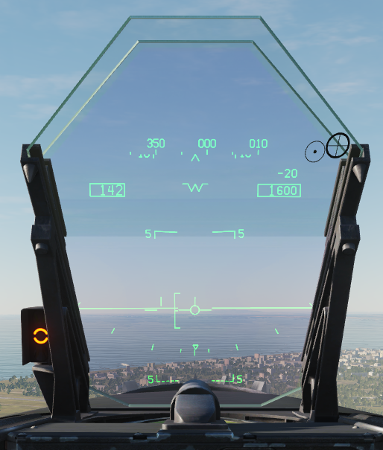
Landing
When lined up on the final approach course, a gradual descent should be achieved whilst keeping the aircraft flying straight.
Displayed on the HUD is an ‘E’ bracket which indicates the optimal AoA for landing.
The aircraft speed is considered ‘correct’ when the Velocity Vector is aligned with the middle of the ‘E’ bracket.
This coincides with a yellow ‘doughnut’ shown on the AoA indicator left of the HUD.
494(P)-BAS-03

Slide 35
Landing
To safely land the aircraft, fly the aircraft maintaining the Velocity Vector in the middle of the ‘E’ bracket until touchdown. The F/A-18C is designed to withstand high-impact carrier landings and accordingly there is no requirement to flare.
Place the velocity vector over the point at which you intend to touch down and manage the pitch and throttle together – pitching down requires a reduction in throttle and vice versa.
Do not look at your speed – if you have ‘on speed’ AoA then your speed is correct.
494(P)-BAS-03

Slide 36
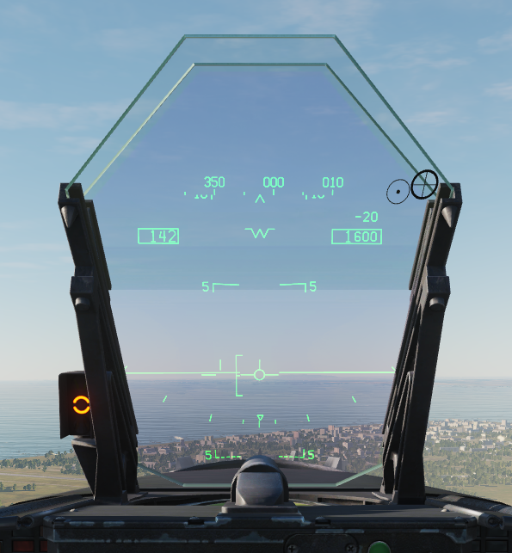
Landing
Whilst performing landings with crosswinds, it may be appropriate to turn the aircraft into the wind to nullify the effect of the crosswind.
In doing so, pressing the ‘CAGE/UNCAGE’ button on the HOTAS will cage the HUD, keeping the velocity vector central in the HUD. A hollow crosshair will replace the velocity vector to indicate drift.
494(P)-BAS-03

Slide 37
Landing
For the majority of the approach, this crosshair will replace the velocity vector – place the crosshair over the intended touchdown zone and fly the approach as normal.
Just before touchdown, ‘kick’ the aircraft using the rudder into a straight line and attempt to touch down with the aircraft oriented down the runway.
This technique requires practice!
494(P)-BAS-03

Slide 38
Conducting a Touch and Go
Conducting a Touch and Go
494(P)-BAS-03

Slide 39
Conducting a Touch and Go
Performing a Touch and Go landing is very similar to a ‘full stop’ landing.
When the aircraft is on the runway, idle the throttle, relax on the controls and ensure that the aircraft is rolling straight down the runway.
Relax on the controls and retract the flaps to ‘HALF’.
Apply afterburner and rotate as per a normal takeoff.
494(P)-BAS-03

